Slide 1
"Encryption/Decryption Web App"
"Securing Your Messages“
Slash mark project(Basic)
Name : uDaykiran

Slide 2
Content:
Introduction
Technologies Used
Screen shots of implemented work
Demonstration of the Project
Conclusion
References

Slide 3
Introduction
Overview of the Project: Encryption/Decryption Web App
In this project, we have developed a straightforward web application with a primary focus on securing textual information through encryption and decryption processes. The fundamental objective is to empower users to safeguard their messages and ensure that even with the same input, strong encryption generates distinct outputs.
Projects hold significant importance in various contexts, including education, professional development, and real-world applications. Here are some key reasons why projects are essential:
Application of Knowledge: Apply theoretical learning to real-world scenarios.
Skill Development: Enhance problem-solving, critical thinking, and soft skills.

Slide 4
3. Hands-on Experience: Gain practical insights and understand real-world challenges.
4. Demonstration of Competence: Showcase proficiency for academic and professional
advancement.
5. Problem Solving: Develop the ability to analyze and solve specific challenges.
6. Creativity and Innovation: Encourage creative thinking and exploration of new ideas.
7. Professional Development: Contribute to career goals and enhance resumes
8. Team Collaboration: Promote teamwork and interpersonal skills.
9. Real-world Impact: Address societal challenges and contribute to research or
improvement.
10. Continuous Learning: Stay engaged and updated on the latest developments in the
field.

Slide 5
Technologies Used
Frontend: HTML, CSS, JavaScript
Backend: cloud memory
Encryption Algorithm: AES(Advance Encryption standard)

Slide 6
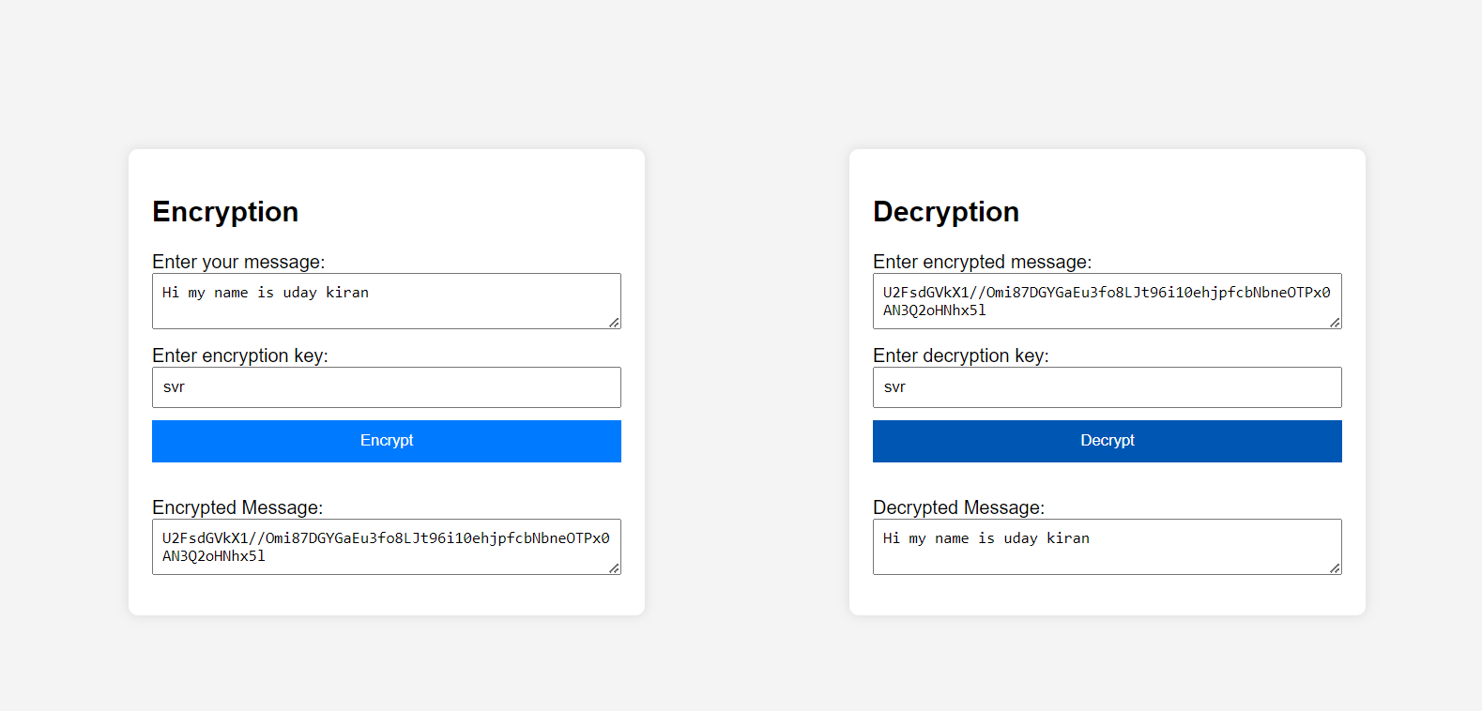
Screen shots of implemented work

Slide 7
Encryption Algorithm
The algorithm used in this project is AES(Advance Encryption Standard) some of the key features of AES are given below.
Type: Symmetric Key Block Cipher
Key Lengths: 128, 192, or 256 bits
Block Size: 128 bits
Adoption: NIST standard since 2001, replacing DES
Symmetric Key: Same key for encryption and decryption
Key Options: 128-bit (common), 192-bit, and 256-bit
Structure: Substitution-Permutation Network (SPN)
Rounds: 10 rounds for 128-bit key, 12 rounds for 192-bit key, and 14 rounds for 256-bit key

Slide 8
Conclusion
In conclusion, the message encryption and decryption project stands as a crucial safeguard for digital communication, ensuring the confidentiality and integrity of sensitive information. Through the implementation of robust cryptographic algorithms and secure key management practices, the project effectively transforms plaintext messages into ciphertext, protecting them from unauthorized access and tampering. By facilitating secure key exchanges and utilizing strong encryption techniques, it plays a vital role in mitigating the risks of data breaches and unauthorized disclosure. In the face of evolving cyber threats, the commitment to regular updates and enhancements in encryption mechanisms is paramount, reinforcing its significance in fortifying digital communication channels and upholding privacy in our interconnected world.

Slide 9
References
NIST Special Publication 800-175B: Guide to Cryptographic Key Management:
This publication by the National Institute of Standards and Technology (NIST) provides guidelines for cryptographic key management, including key generation, distribution, storage, and more.
AES (Advanced Encryption Standard) Specification:
The official AES specification, FIPS PUB 197, outlines the encryption and decryption processes using the Advanced Encryption Standard. It's crucial to understand the details of the algorithm you are implementing.
RSA Algorithm Documentation:
Refer to the original RSA algorithm documentation or publications by its inventors, Ron Rivest, Adi Shamir, and Leonard Adleman. Understanding the RSA algorithm is fundamental for public-key cryptography.
OpenSSL Documentation:
If you are using OpenSSL for implementing cryptographic functions, their official documentation (https://www.openssl.org/docs/) provides comprehensive information on using the library for various encryption and decryption tasks.

Slide 10

This Photo by Unknown Author is licensed under CC BY

